Slide 1
CAge: Taming Certificate Authorities by Inferring Restricted Scopes
By James Kasten, Eric Wustrow, and J. Alex Halderman

Slide 2
Outline
X.509 Certificate Authority System
Certificate Authority (CA) Compromises
Analyze the CA Infrastructure
CAge
Evaluation
Conclusion

Slide 3
Background
Secure Online Transactions
  Electronic Commerce
  Banking
  Secure Email
HTTPS
  Transport Layer Security (TLS)
    Confidentiality
    Integrity
    Authenticity

Slide 4

TLS Authentication
Defends against Man-in-the-Middle Attack
Mallory
GET bank account
GET bank account
Bank
You
Sensitive info
Sensitive info
GET bank account
Sensitive info

Slide 5
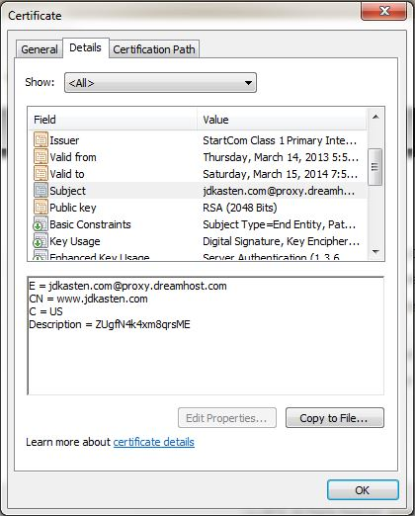
Certificate Authentication
X.509 Certificate
  Ties domain to public key
  Contains
    Subject
      Common Name (CN)
        Domain
    Subject’s Public Key
    Issuer (Certificate Authority)
    Validity Period
    Basic Constraints

Slide 6


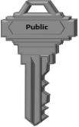

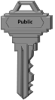
HTTPS Certificate Authentication
Setup
  Request a certificate from a CA
  CA verifies ownership of the domain
  CA issues signed certificate
Authentication
domain.com
Verisign
TLS: Client Hello
domain.com
Certificate
Verisign

Slide 7
Problem
Certificate Authority Compromise
Widespread attack on Gmail
  *.google.com certificate
  Over 300,000 Iranian users in 40 different ISPs
  DigiNotar
    Small Dutch Certificate Authority
      Handled Dutch Government PKI
Notes:
Late august 2011
Compromised july 10

Slide 8
More Damage
Discovered 531 other DigiNotar fraudulent certificates
  Not even revoked
Removed from Browsers
  Bankrupt within one month
*.*.com
*.*.org
twitter.com
facebook.com
wordpress.com
login.yahoo.com
*.skype.com
www.cia.gov
addons.mozilla.org
Verisign Root CA
Comodo Root CA

Slide 9
Isolated Incident?
Certificate Authority Compromises
  Comodo Attack
    Comodo Reseller Account Compromised
    9 high profile certificates were fraudulently issued
    Certs explicitly blacklisted in browser updates
      Comodo is too big to fail
“Anyway, I know you are really shocked about my knowledge, my skill, my speed, my expertise and entire attack. That’s OK, all of it was so easy for me, I did more important things I can’t talk about, so if you have to worry, you can worry… I should mention my age is 21”
”I’m not a group of hacker, I’m single hacker with experience of 1000 hackers, I’m single programmer with experience of 1000 programmers, I’m single planner/project manager with experience of 1000 project managers, so you are right, it’s managed by a group of hackers, but it was only I with experience of 1000 hackers.”

Slide 10
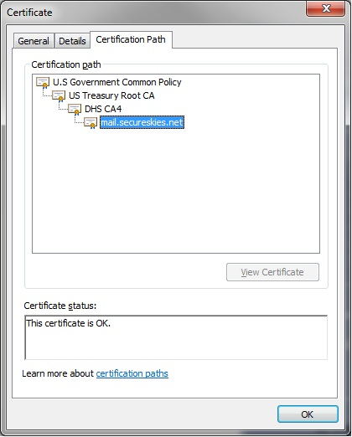
Certificate Authority Trust Model
How many people do you trust?
  Mozilla has 124 root CAs
  Apple trusts 180 root CAs
  Microsoft trusts more than 300 roots (including hidden roots)
Certificates are chained
  Generally without restriction
So, how many people do you really trust?
Notes:
Chrome uses OS certs
Mention how CA certs get into browsers… Mozilla Policy

Slide 11
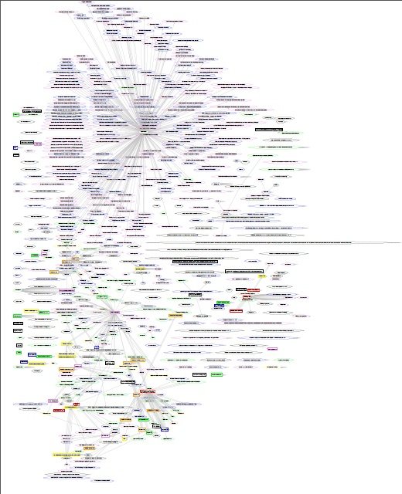
Web of Trust
Querying every public IP yielded 1.9 million unique trusted certs
1320 distinct CA certificates
More than 650 CA organizations
Notes:
~1320 public keys from more than 650 organizations

Slide 12
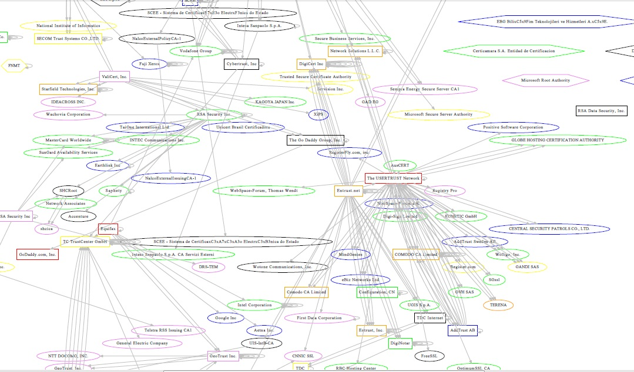
A Closer Look

Slide 13












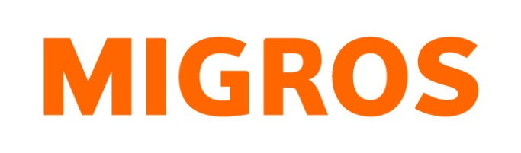


Who are these CAs?

Slide 14
Highly Distributed Trust Model
Any trusted CA can sign for any domain
Does this violate the principle of least privilege?

Slide 15
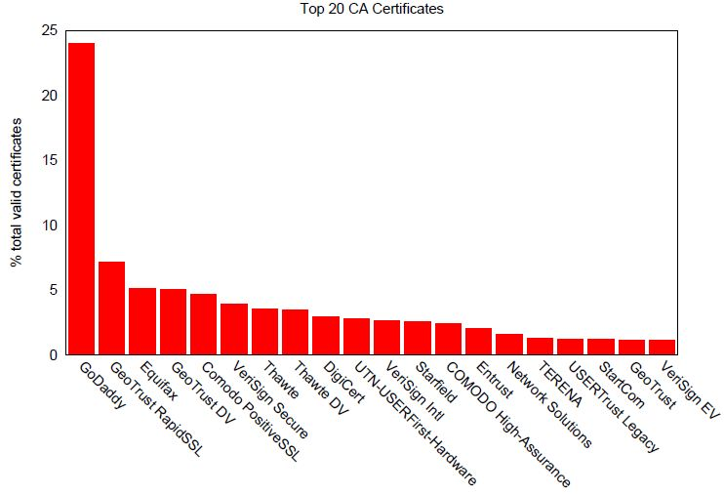
Most Prevalent CA Certificates
80% of all trusted certificates are signed by 20 CA certs
Notes:
One certificate has signed for almost a quarter of the internet

Slide 16
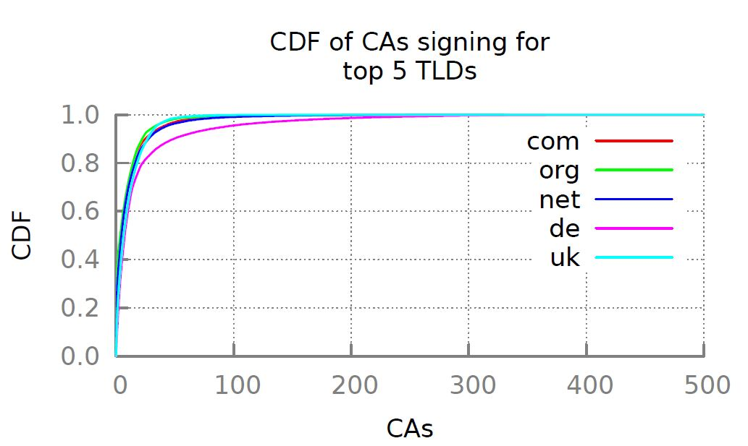
TLD CA Signing Distribution
420 have ever signed for .com
Notes:
35% have ever signed for a .com - 420
20% have signed for 10 or more
89.3% have signed for fewer than 10 TLDs
15 -> 80% .com
25 CAs have sigend for 90% .com
You can notice the effect of the german universities
Having this power is only useful for attackers

Slide 17
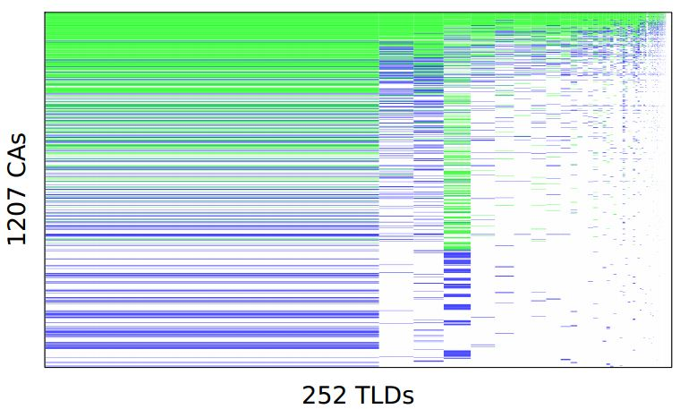
CA/TLD Matrix

Slide 18


Restricted Scopes
twitter.com google.com
wordpress.com
*.fh-rosenheim.de login.live.com
addons.mozilla.org
weblogin.umich.edu
facebook.com www.cia.gov
torproject.org
*.disney.com
secure.logmein.com

Slide 19
CAge
Inferred Restricted Scopes
  Initialization and Rule Inference
    Attain Ground Truth
    Develop rules based on CA behavior
  Enforcement and Exception Handling
    Implemented at the browser level
  Updating

Slide 20
Initialization and Rule Inference
Collect data on existing CA practices
  Certificate scans
Rule Inference Algorithm
  Goals
    Capture CA’s signing policy
      Low false positive rate
  Input
    CA domain signing behavior
  Output
    CA Restricted Scopes
      Stored as regular expressions
Notes:
Parse through subject and subject alternative names

Slide 21
Possible Policies
Limit Governmental Agencies and Private Companies
  Restrict to personal second-level domains
    *.gov.br
    *.disney.com
Restrict by Top-Level Domain (TLD)
  Have they signed for this TLD before?
  How many times?
Weighted TLD rules
  False Positive vs. Protection Tradeoff
    Better results if .com TLD is more strict
Notes:
Explain tradeoff

Slide 22
Top-Level Domain Policy
C=JP, O=Japanese Government, OU=ApplicationCA - 54:5A:CB:26:3F:71:CC:94:46:0D:96:53:EA:6B:48:D0:93:FE:42:75
*.jp - 104
C=JP, O=KAGOYA JAPAN Inc., CN=KAGOYA JAPAN Certification Authority - D8:77:D6:6D:51:49:07:83:60:07:B9:45:15:7F:61:C1:8A:1F:F2:5E
*.com - 63
*.info - 1
*.jp - 78
*.net - 12
*.biz - 4
C=JP, O=LGPKI, OU=Application CA G2 - 7F:B8:5D:8E:C4:18:6B:C6:7D:CC:2E:E9:AE:CE:34:E7:17:5D:E0:A1
*.jp - 148
Can sign for: *.jp
Can sign for: *.com
*.info
*.jp
*.net
*.biz
Can sign for: *.jp
Exceptions - 0

Slide 23
Top-Level Domain Policy
C=JP, O=Japanese Government, OU=ApplicationCA - 54:5A:CB:26:3F:71:CC:94:46:0D:96:53:EA:6B:48:D0:93:FE:42:75
*.jp - 104
C=JP, O=KAGOYA JAPAN Inc., CN=KAGOYA JAPAN Certification Authority - D8:77:D6:6D:51:49:07:83:60:07:B9:45:15:7F:61:C1:8A:1F:F2:5E
*.com - 63
*.info - 1
*.jp - 78
*.net - 12
*.biz - 4
C=JP, O=LGPKI, OU=Application CA G2 - 7F:B8:5D:8E:C4:18:6B:C6:7D:CC:2E:E9:AE:CE:34:E7:17:5D:E0:A1
*.jp - 148
Can sign for: *.jp
Can sign for: *.com
*.jp
*.net
*.biz
Can sign for: *.jp
Exceptions - 1
www.interbrandjapan-seminar.info

Slide 24
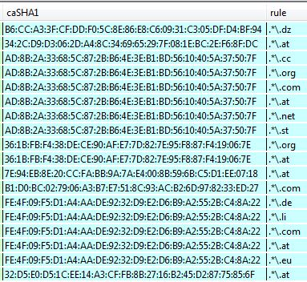
Enforcement and Exception Handling
Browser additionally checks CA against rules
  Incentives align
  Restrictions applied immediately
Exceptions
  Check for updates
  Issue warning to the user
  Ask if the user would like to report for further analysis
    Multi-Path probing
Notes:
No changes to infrastructure… no required negotiations with CAs

Slide 25
Effectiveness – Defense in Depth
Small set of examples
Small Commercial or Private CA
  Would have limited the DigiNotar Attack
    Compromised CA hadn’t signed for any .com certificates
Large Commercial CA
  Not effective against the Comodo Attack
    CA had signed 25,000 other .com certificates

Slide 26
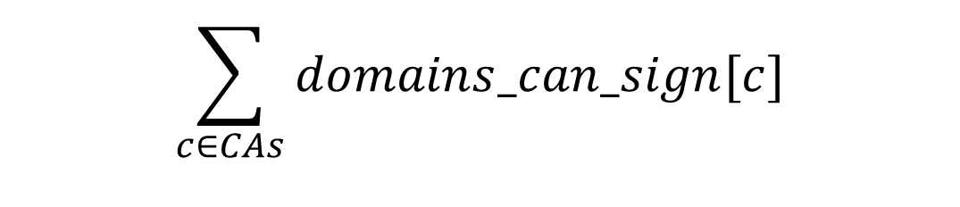
Attack Surface Reduction
Attack Surface Metric
Current attack surface
  (# Protected Domains) x (# CA certs)
    2.5 million unique protected domains
  $$\sum_{c∈CAs}{domains_can_sign[c]}$$
Notes:
Change to current attack surface, first is generalized form, go through derivation… across multiple slides

Slide 27
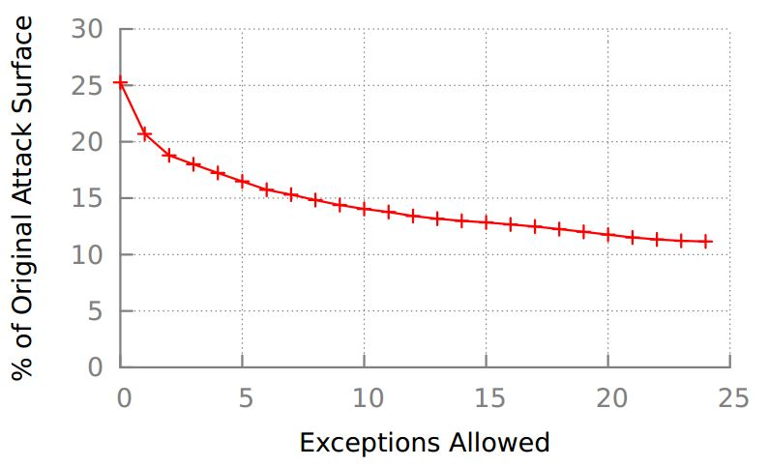
Attack Surface with TLD Policy
Notes:
Compare to initial all names policy
Hit with the big number 90%
Attack surface is rough estimate

Slide 28


Updating
Issued on per domain basis
  Mechanisms based on inference are subject to attack
Attack Scenario
*.google.com
*.nl
facebook.com

Slide 29
Updating
Issued on per domain basis
  Mechanisms based on inference are subject to attack
Attack Scenario
*.google.com
blackhat1.com
blackhat2.com
*.nl
blackhat3.com
facebook.com

Slide 30

Updating
Issued on per domain basis
  Mechanisms based on inference are subject to attack
Attack Scenario
*.google.com
blackhat1.com
blackhat2.com
*.nl
blackhat3.com
facebook.com

Slide 31
Updating
Issued on per domain basis
  Mechanisms based on inference are subject to attack
Attack Scenario
*.google.com
blackhat1.com
blackhat2.com
*.nl
blackhat3.com
facebook.com

Slide 32
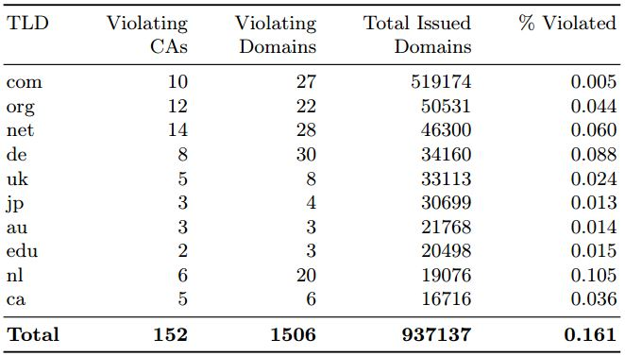
Rule Violations after 6 Months
Notes:
99.839%

Slide 33
Conclusion
CAs do not use their unconstrained signing power
CA signing behavior is generally static
  CA profiles can be developed
Restricted scopes can dramatically reduce the attack surface
The cost of deploying CAge is relatively low

Slide 34
Questions

